Slide 1


Slide 2

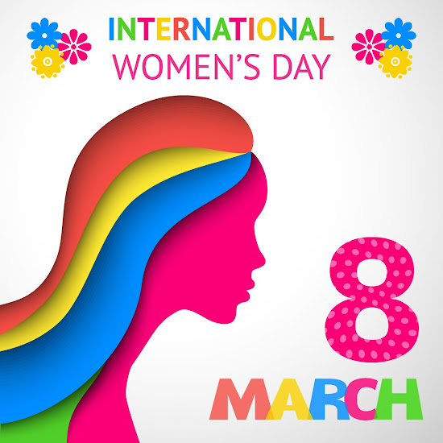


Introduction to International Women's Day
International Women's Day is a global day celebrating the social, economic, cultural, and political achievements of women. It also marks a call to action for accelerating gender parity.
The day has been observed since the early 1900s and is recognized annually on March 8th. It is a time to reflect on progress made and to advocate for change in the current landscape of gender equality.
by Working
This Photo by Unknown Author is licensed under CC BY

Slide 3

History and significance of International Women's Day
1
Early Beginnings
International Women's Day has its roots in the early 20th century women's labor movements.
2
Becoming an Official Day
It was first celebrated by the United Nations on March 8, 1975.
3
Global Recognition
It has since grown as a day to recognize and celebrate women's achievements worldwide.

Slide 4


Theme for this year's International Women's Day
Gender Equality
Inclusive Leadership
Women's Empowerment
This year's theme focuses on advocating for gender equality in all aspects of life.
Highlighting the importance of inclusive leadership to drive positive change.
Empowering women to achieve their full potential without any barriers.

Slide 5
Achievements and Progress in Women's Rights
Legal Rights
Education and Employment
Health and Reproductive Rights
Over the years, women have gained legal rights, including the right to vote and gender equality legislation.
Women have made significant progress in accessing education and pursuing careers in traditionally male-dominated fields.
Women's health has become a priority, with advancements in reproductive rights, maternal healthcare, and access to family planning.
Many countries have recognized and implemented laws to protect women from discrimination and ensure their equal treatment.
There has been a rise in female representation in leadership positions in various industries and sectors.
Efforts have been made to address issues such as maternal mortality and ensure comprehensive healthcare for women.

Slide 6

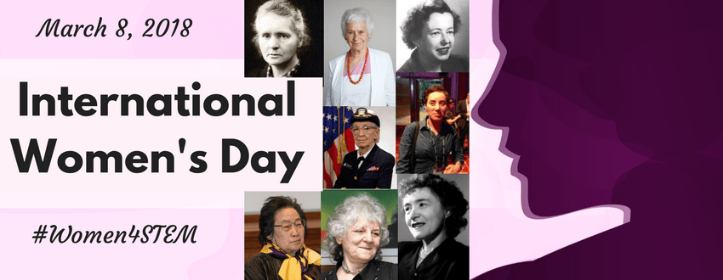
Challenges and barriers still faced by women worldwide
Gender Pay Gap: Women continue to earn less than men for the same work, affecting their financial security.
Gender-Based Violence: Women are disproportionately affected by domestic violence, sexual assault, and harassment.
Limited Access to Education: In many parts of the world, girls still face barriers to accessing quality education.

Slide 7
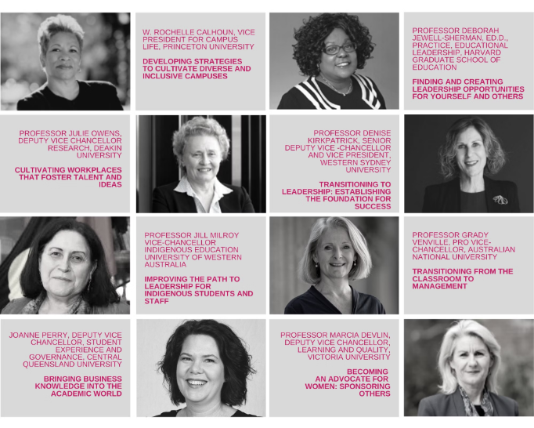
Empowering Women Through Education and Economic Opportunities
Education is a powerful tool for empowering women, providing them with knowledge, skills, and the confidence to pursue their goals.
Access to economic opportunities enables women to achieve financial independence, contribute to their communities, and break the cycle of poverty.

Slide 8
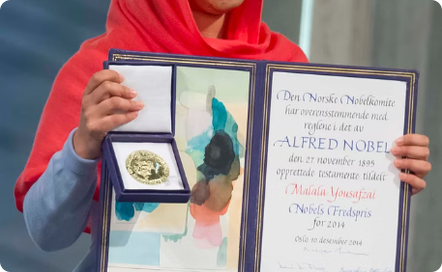


Celebrating the Achievements of Inspirational Women
Malala Yousafzai
Serena Williams
Greta Thunberg
Malala Yousafzai, a Pakistani activist for female education, became the youngest Nobel Prize laureate for her advocacy.
Serena Williams, a tennis icon, has triumphed with 23 Grand Slam singles titles, inspiring women in sports.
Greta Thunberg, a prominent climate activist, has mobilized a global movement demanding urgent action on climate change.

Slide 9


Promoting Gender Equality in the Workplace
Inclusive Leadership
Equal Pay
Creating a culture where diverse voices are heard and valued is essential.
Ensuring that all employees are paid fairly for their work regardless of gender.
This Photo by Unknown Author is licensed under CC BY-NC
Career Development Opportunities
Work-Life Balance Support
Offering flexible schedules and family-friendly policies for all employees.
Providing equal access to training, mentoring, and advancement for everyone.

Slide 10
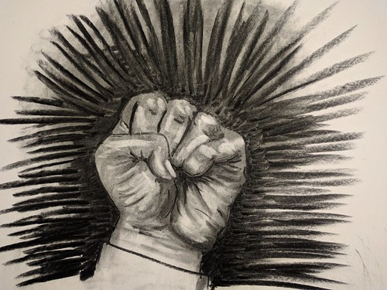
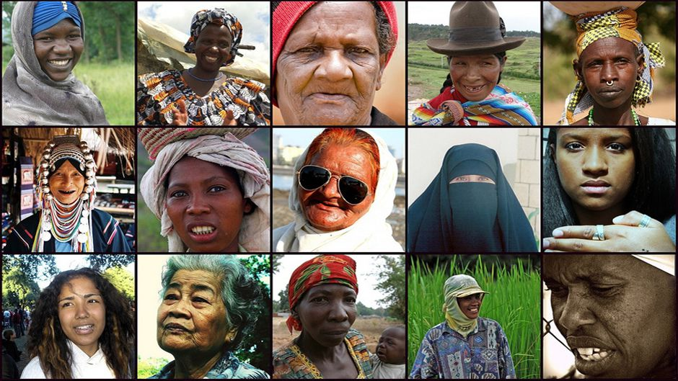





Unity
Amplify
Education
Equality
This Photo by Unknown Author is licensed under CC BY
Supporting and standing in solidarity with women globally.
Amplifying the voices of marginalized women and advocating for their rights.
Supporting educational opportunities for girls and women.
Working towards creating equal opportunities for women in all sectors.

Slide 11


The Importance of International Women's Day
International Women's Day is a crucial reminder of the ongoing fight for gender equality.
It serves as a platform to celebrate the achievements of women and advocate for a more inclusive and equitable world.
This day highlights the need for continuous efforts in empowering women and creating a diverse, balanced society.
It is a significant step towards building a future where every woman has the opportunity to thrive.

Slide 12



This Photo by Unknown Author is licensed under CC BY-NC
This Photo by Unknown Author is licensed under CC BY-NC

